Slide 1
Atomic structure-3
25/07/2023
Dr. Muhammed Shah Miran
Professor, Department of Chemistry
University of Dhaka, Dhaka 1000

Slide 2
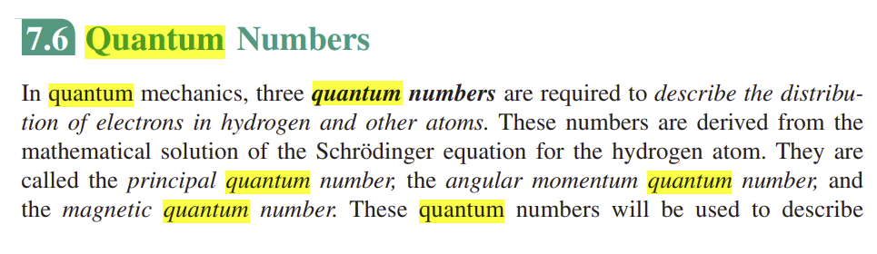
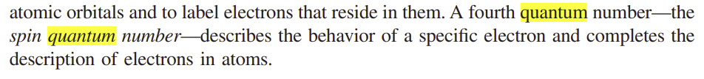

Slide 3
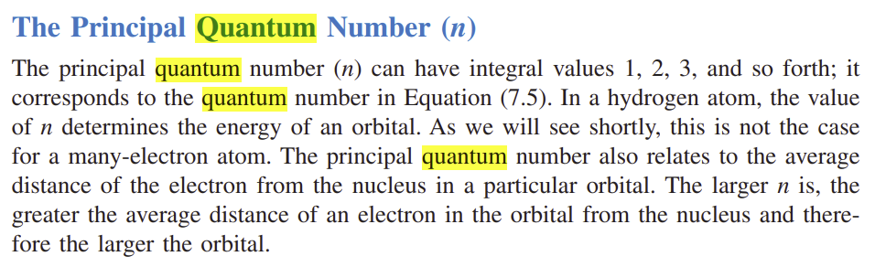

Slide 4
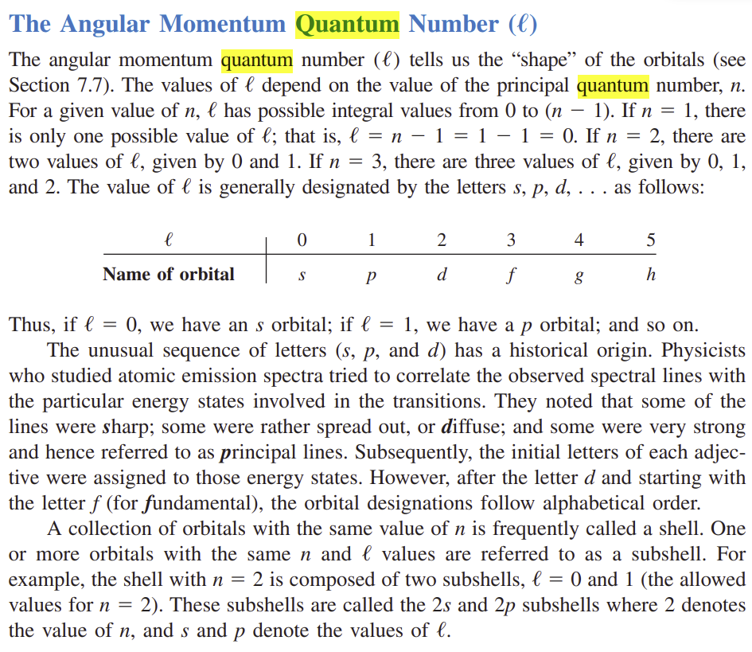

Slide 5
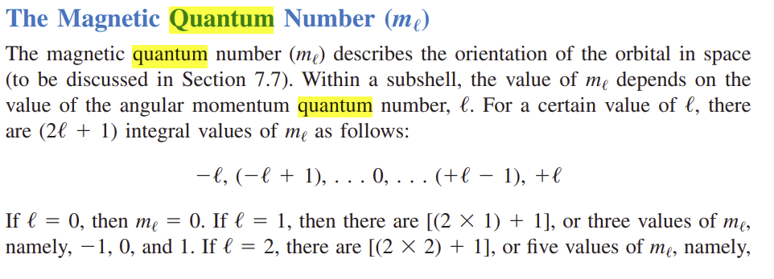
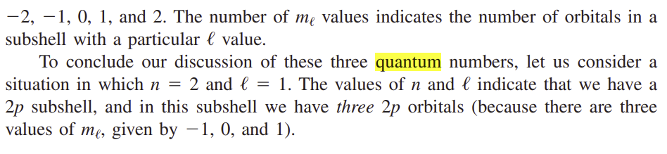

Slide 6
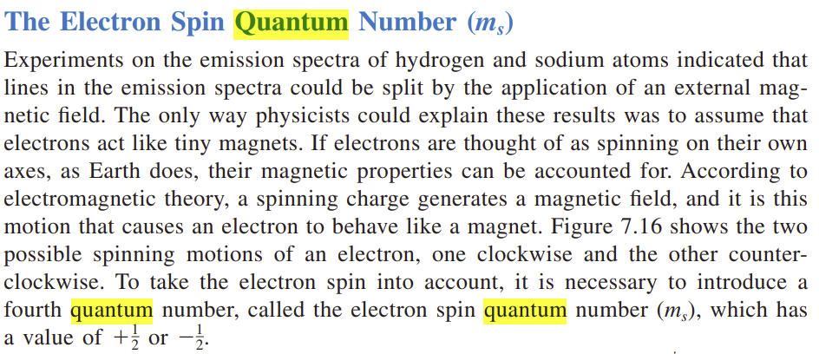

Slide 7
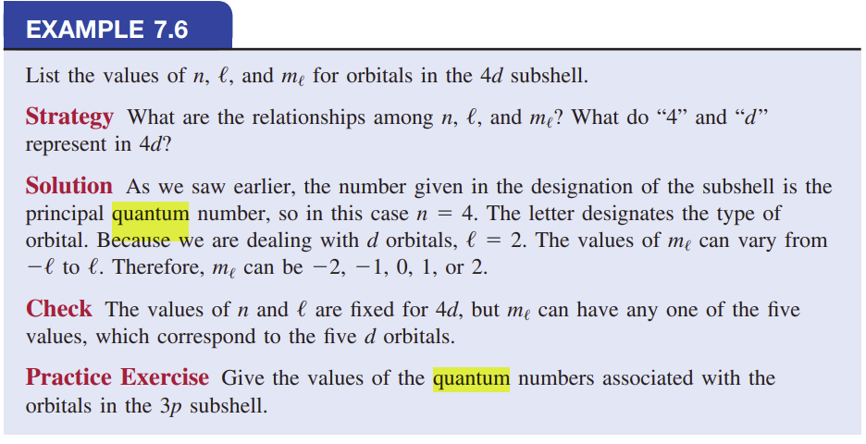

Slide 8
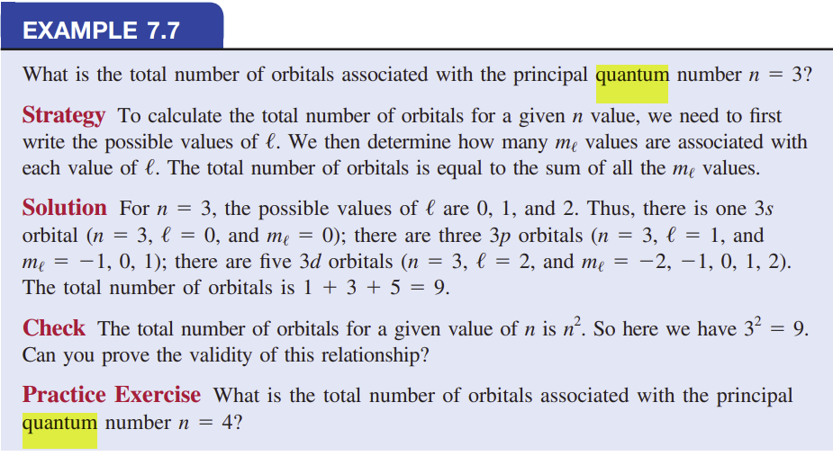

Slide 9
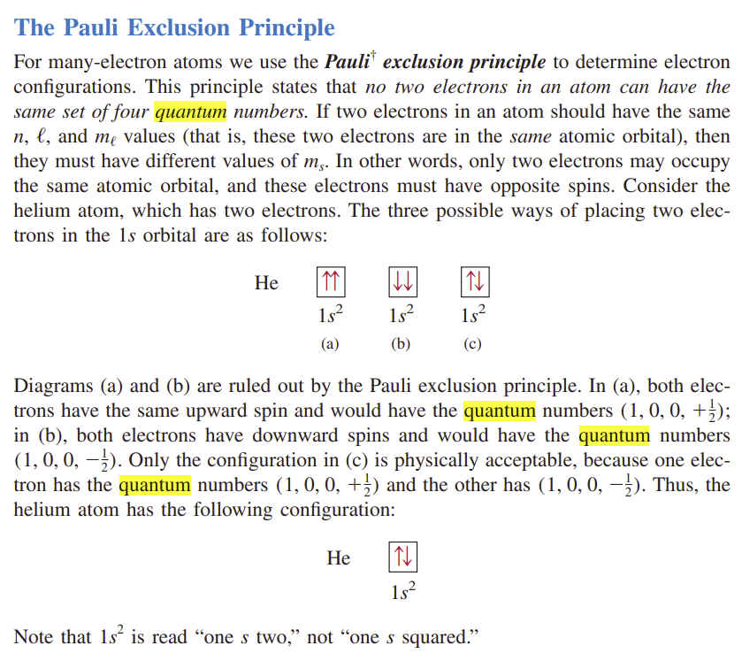

Slide 11
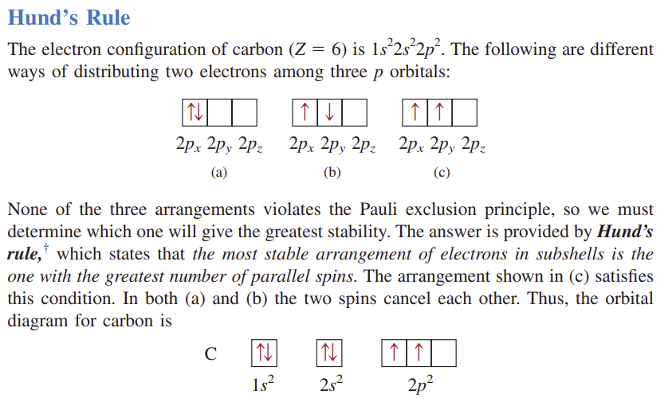

Slide 12
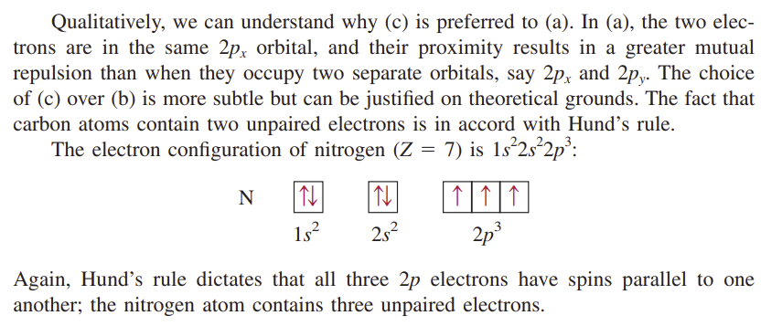

Slide 13
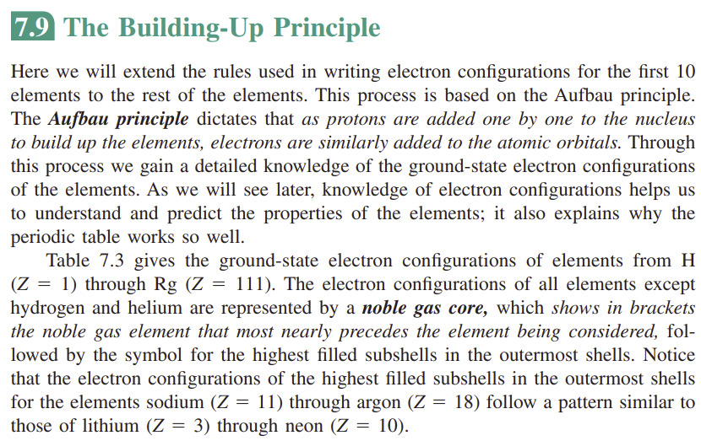

Slide 14
Define quantum numbers. Calculate the value of l, m and number of electrons of the orbitals when n = 1, 2, 3, 4.
What are quantum numbers? Which orbitals are possible among 2s, 2d, 3f and 4f?
What are the significances of quantum numbers?
Discuss the following :
Hund’s Rule of Maximum multiplicity.
Pauli’s Exclusion Principle.
Aufbau principle

